Slide 1
Competitive Solar Incentive (CSI) Program
Stakeholder Meeting #3
June 1, 2022

Slide 2
Welcome
This is the third public stakeholder meeting for the design of the CSI Program under
Docket # QO21101186
Competitive Solar Incentive (“CSI”) Program
pursuant to P.L. 2021, C.169
In addition, two stakeholder meetings were held on the Solar Siting Straw Proposal under the same docket

Slide 3
Covered in this meeting
This meeting will focus on the following part of the CSI Straw Proposal released on April 26, 2022:
Section IV.B - Project pre-qualification, bid participation fees, and commercial operation date requirements

Slide 4
Webinar Instruction Page
All attendees will be automatically muted
Questions? Please use the “Q &A” function in Zoom
We will address clarifying questions at the end of each section
Please note that the “Chat” function in Zoom is not available for this meeting
This meeting is being recorded. A copy of the recording and slides will be made available on the BPU website: https://www.nj.gov/bpu/newsroom/public/

Slide 5
Disclaimer
This presentation is provided for informational purposes only and should not be taken to represent the views of the New Jersey Board of Public Utilities, its Commissioners, or the State of New Jersey. Please be aware that any information presented is subject to change if there are changes to New Jersey statutes, rules, or policies.
All viewers are responsible for ensuring that they rely only on current legal authority regarding the matters covered in the presentation.

Slide 6
Written Stakeholder Comment Guidelines
The deadline for comments on the CSI Straw is 5:00 p.m. ET on Monday, June 20, 2022.
Please submit comments directly to Docket No. QO21101186, using the “Post Comments” button on the Board’s Public Document Search tool.
Comments are considered “public documents” for purposes of the State’s Open Public Records Act and any confidential information should be submitted in accordance with the procedures set forth in N.J.A.C. 14:1-12.3.
Written comments may also be submitted to:
Carmen D. Diaz
Acting Secretary of the Board
44 South Clinton Avenue, 1st Floor
Post Office Box 350
Trenton, NJ 08625-0350
Phone: 609-292-1599
Email: board.secretary@bpu.nj.gov

Slide 7
Competitive Solar Incentive (“CSI”)
Program
Stakeholder Meeting #3
June 1, 2022
DAYMARK ENERGY ADVISORS
NJ BPU
June 1, 2022

Slide 8
Topics of today’s discussion
Topic
Importance
Project pre-qualification
Bid participation fees
Commercial operation date requirements
Ensure projects are eligible for the particular tranche, ensure projects are sufficiently mature and through the development process such that likelihood of completion is high.
Discourage speculative participation in the CSI process, help defray program costs.
Provides requirements to ensure timely completion of projects therefore ongoing progress towards NJ’s solar goals at the least cost to ratepayers.

Slide 9
Topics of Today’s Discussion
Dealing with uncertainty and extended timelines in the interconnection process, especially on the FERC-jurisdictional (PJM) side
Managing requirements such that CSI Program does not impose excessive barriers and therefore limit participation (to the detriment of competition and ratepayer costs)
Ensure projects get built, produce solar RECs (SREC-IIs), and support NJ’s solar goals

Slide 10
Key themes from November stakeholder comments
Uncertainty for grid supply projects in the PJM queue
Element of tradeoff regarding queue stage:
Advanced stage (e.g. completed Facilities Study) → high degree of certainty regarding interconnection costs and remaining timeline
However, reaching such a stage could take several years and large deposits to PJM
Developers indicated that the earlier the incentive can be provided, the more value to projects navigating interconnection
Site control as a possible maturity benchmark

Slide 11
Key themes from November stakeholder comments (2)
Pre-qualification for net metered projects:
Letter of intent with host location or
Part 1 interconnection agreement with EDC
Bid participation fees: highly mixed feedback
Useful in discouraging speculative projects, but in excess could hurt development
Two years from SREC-II award to COD was regarded as appropriate, potentially longer for contaminated land projects

Slide 12
Project Prequalification Recommendations

Slide 13
Project Prequalification Recommendations
“At the end of each bidding round, the board shall:
(1) rank all bids received based on the bid price, or, pursuant to subsection b. of this section, based on the bid price within each category;
(2) select bids in ranked order, up to the procurement budget set by the board, or, pursuant to subsection b. of this section, the procurement budget of each category;”
P.L. 2021 c.169 (NJ Solar Act of 2021)
The Board will not evaluate qualitative factors as some other states do
It is important for the projects being ranked to be of some minimum quality and maturity

Slide 14
Elements of Pre-qualification
Demonstration of tranche eligibility
Built environment
Contaminated land
Verification of compliance with siting requirements
Location outside prohibited areas
Location outside restricted areas or waiver
Compliance with caps on farmland, if applicable
Demonstration of project maturity
Payment of bid participation fee, if applicable
Notes:
I think that we need a slide like this, summarizing.

Slide 15
Project Prequalification Recommendations
Projects would be required to demonstrate compliance with pre-qualification in a process approximately one month before bid submission deadlines
Non-FERC-jurisdictional projects must provide evidence of having filed an interconnection application with the EDC and receiving conditional approval
FERC-jurisdictional projects must demonstrate a queue position similar to a Feasibility Study

Slide 16
Side note: Proposed Prequalification for projects sited on covered farmland
Caps do not apply to all projects on farmland—only projects on farmland that is in Agricultural Development Areas and on Prime Soils or Soils of Statewide Importance
Prequalification for projects on farmland in Agricultural Development Areas and on Prime Soils or Soils of Statewide Importance will involve verification that the project - Is not sited on Preserved Farmland - Does not by itself cause the 2.5% statewide threshold to be exceeded - Does not by itself cause the applicable 5% County Concentration Limit to be exceeded

Slide 17
Side note: Screening for covered farmland cap in bid review process
Select pre-qualified bids from lowest cost to higher cost to meet minimum target
Track how selected bids fill up the available covered farmland allowance
If/when covered farmland allowance is reached, bids utilizing covered farmland will be skipped over in favor of the next most competitive bid

Slide 18
Open issue: How to use PJM interconnection process in project pre-qualification
Considerations:
Outcome of PJM Queue Reform
Impact on timing of project construction vs award
Implications for pool of projects available for initial procurement
Implications for projects
With existing queue positions
Not yet in the queue

Slide 19
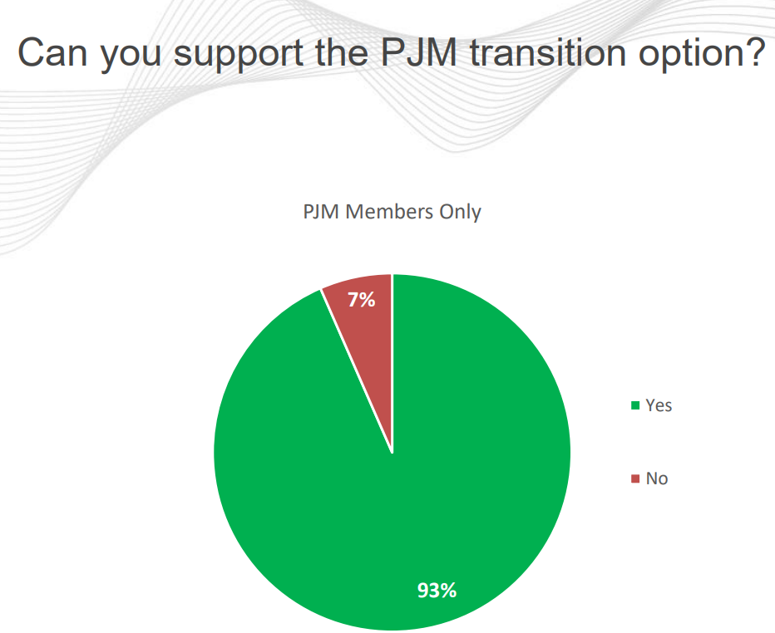
Status: where the new PJM process proposal is at
A PJM transition proposal gained necessary support in IPRTF late 2021
In the intervening meetings, the task force has processed tariff updates
April 2022: Markets & Reliability Committee & Members Committee endorsement
May 2022: transition proposal to be filed with FERC
October 2022: proposed start of new process

Slide 20
Implications for timing of projects now in the PJM queue
Approx. Queue Date
Estimated Final Agreement
Queues through AD2 continue in current process
Fast Lane: ~450 projects from queues AE1-AG1 which have upgrade costs <= $5 million
Transition Cycle 1: Re-queued projects from AE1 through AG1
Transition Cycle 2: Queues AG2 through AH 1
11/2017 –
3/2018
10/2022
4/2018 –
9/2020
9/2024
4/2018 –
9/2020
4/2025
10/2020 –
9/2021
6/2026

Slide 21
Analysis of how queue timing may affect potential CSI projects
We recognize that the first solicitation will only allow for projects that have already entered into the PJM queue
Projects already in the PJM queue are expected to execute final interconnection agreements between mid-2024 and mid-2026
As of May 2022, there are 77 NJ solar projects active in the queue with a total capacity of 1,645 MW. Thirty-five projects totaling 891 MW have at least a completed Feasibility Study.
Some of these projects may have received awards under the TI Program and therefore would be ineligible to compete in the CSI Program.
There also may be projects eligible for the CSI Program that proceed through a non-FERC interconnection process
New cycle #1: Queue open mid-2023 and final interconnection agreements expected to be completed in late 2027.

Slide 22
For discussion: Understanding impacts of PJM Queue Reform
Impacts on projects in the queue
Impacts on projects not yet in the queue
Potential participation from queue-exempt projects
Notes:
This slide should come before Slide 18

Slide 23
Bid Participation Fee/Escrow Recommendations

Slide 24
Bid participation fee – reference states
State
Details
New York
Massachusetts
Illinois
Non-refundable according to the schedule below
$25 / kW performance guarantee refunded to unsuccessful bidders and selected bidders who meet Program Effective Date requirements
$10/ kW non-refundable application fee, not to exceed $5,000 per project

Slide 25
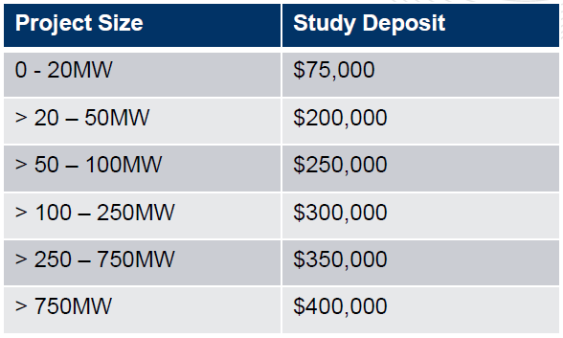
PJM’s proposed process – deposits summary
Study Deposit
Readiness Deposit
Covers study costs
10% non-refundable
Due one time at beginning of study process
Funds committed based on project size/study results
Not used to fund studies
Determined at the time they are due; not refunded or reduced based on later project reductions or cost allocation changes
Notes:
No comments

Slide 26
Bid participation fee/escrow recommendations
Recommended bid fee of $1,000/MW
Public entities exempt from bid fees
No escrow/project security deposits

Slide 27
Commercial Operation Date (“COD”) Recommendations

Slide 28
Commercial Operation Date Recommendation
COD Requirements are needed to ensure that the awards are in line with cost structures at the time the projects are built
Recommend 3-year COD deadline—For awards made in 2023, deadline would be 2026.
We consider this in line with a pre-qualification requirement of an existing PJM queue position
NOTE: Commercial Operation Date requirement needs to fit with PJM queue requirements
Notes:
While some other states employ a price + qualitative evaluation in selecting projects, the board must rank based on price. Therefore it becomes necessary to screen projects to ensure those competing on price have a certain likelihood to reach completion.

Slide 29
How to provide stakeholder input
Stakeholder Meeting #3
Today (June 1, 2022)
Stakeholder Meeting #4
June 6 , 2022 (1 P.M.)
Comments Due
June 20, 2022 (5 P.M.)

Slide 30
Stakeholder Comments
Depending on number of registrants, speaking time per person may be limited to 5 minutes—please be respectful of other speakers.
The next five speakers are posted in the chat. We will call on speakers in order. If your name is not showing (only a phone number), please raise your hand when it is your turn to speak.
Phone controls for participants
The following commands can be entered via DTMF tones using your phone's dial pad while in a Zoom meeting:
*6 - Toggle mute/unmute
*9 - Raise hand
At the conclusion of our pre-registered speakers list, we will invite additional speakers to raise their hands to speak.

Slide 31
Thank you
Carrie Gilbert
Louisa Lund
DAYMARK ENERGY ADVISORS
Our team brings deep knowledge and an integrated view of energy infrastructure, regulation, and markets to help our clients make well-informed business, capital investment, and policy decisions in the face of transformative change to achieve decarbonization.
DaymarkEA.com

Slide 32
Stakeholder Comments

Slide 33
Written Stakeholder Comment Guidelines
The deadline for comments on the CSI Straw is 5:00 p.m. ET on Monday, June 20, 2022
Please submit comments directly to Docket No. QO21101186, using the “Post Comments” button on the Board’s Public Document Search tool.
Comments are considered “public documents” for purposes of the State’s Open Public Records Act and any confidential information should be submitted in accordance with the procedures set forth in N.J.A.C. 14:1-12.3.
Written comments may also be submitted to:
Carmen D. Diaz
Acting Secretary of the Board
44 South Clinton Avenue, 1st Floor
Post Office Box 350
Trenton, NJ 08625-0350
Phone: 609-292-1599
Email: board.secretary@bpu.nj.gov

Slide 34
THANK YOU – Let’s continue the conversation veronique.oomen@bpu.nj.gov

